Slide 1
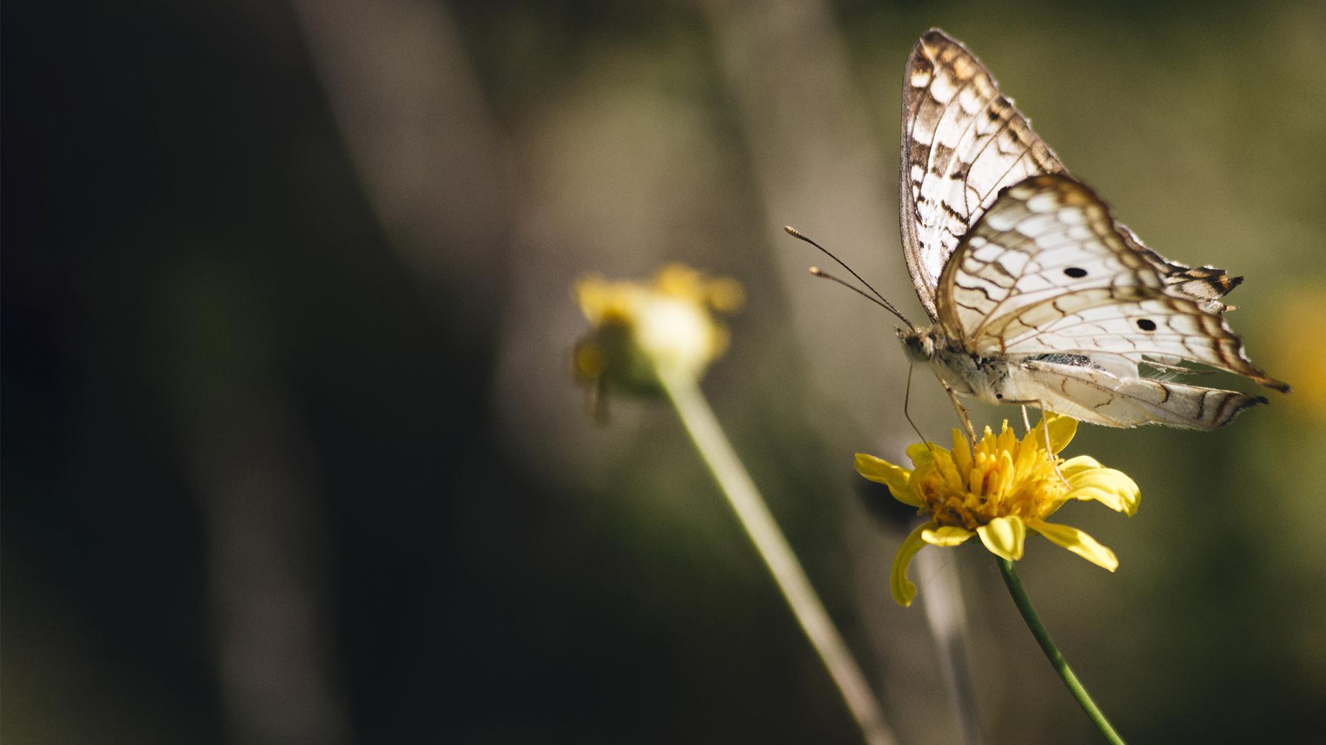

NATURE MERIT BADGE
Troop 344 and 9344
Pemberville, OH

Slide 2
Nature Merit Badge Requirements
Name three ways in which plants are important to animals. Name a plant that is important to animals that is protected in your state or region, and explain why it is at risk.
Name three ways in which animals are important to plants. Name an animal that is protected in your state or region, and explain why it is at risk.
Explain the term "food chain." Give an example of a four-step land food chain and a four-step water food chain.

Slide 3
Nature Merit Badge Requirements
Do all the requirements in FIVE of the following fields:
  BIRDS
    In the field, identify eight species of birds.
    Make and set out a birdhouse OR a feeding station OR a birdbath. List what birds used it during a period of one month.
  MAMMALS
    In the field, identify three species of wild mammals.
    Make plaster casts of the tracks of a wild mammal.
  REPTILES and AMPHIBIANS
    Show that you can recognize the venomous snakes in your area.
    In the field, identify three species of reptiles or amphibians.
    Recognize one species of toad or frog by voice;
    OR identify one reptile or amphibian by eggs, den, burrow or other signs.

Slide 4
Nature Merit Badge Requirements
Do all the requirements in FIVE of the following fields:
  INSECTS and SPIDERS
    Collect and identify either in the field or through photographs 10 species of insects or spiders. Photos may be taken with your own equipment or gathered from other sources.
    Hatch an insect from the pupa or cocoon;
    OR hatch adults from nymphs;
    OR keep larvae until they form pupae or cocoons;
    OR keep a colony of ants or bees through one season.
  FISH
    Identify two species of fish native to your area.
    Collect four kinds of animal food eaten by fish in the wild.
  MOLLUSKS AND CRUSTACEANS
    Identify five species of mollusks and crustaceans.
    Collect, mount, and label six shells.

Slide 5
Nature Merit Badge Requirements
Discuss the importance of the Leave No Trace Seven Principles and the Outdoor Code and how they relate to nature. Explain how you have followed the Leave No Trace Seven Principles and the Outdoor Code while in natural areas during field observation, specimen collection, and identification.
Do the following:
  Explain what succession is to your counselor.
  Visit a natural area (forest, grassland, meadow, water feature) and explain what stage of succession (both plant and animal) the area is in. Talk about what community/succession stages may have been there before and what community/succession stages may replace what you see now. Discuss what disturbances or changes have taken place in the past to create this landscape and what changes may occur in the future to change the landscape further.

Slide 6
Nature Merit Badge Requirements
Do ONE of the following:
  Identify three career opportunities that would use skills and knowledge in Nature. Pick one and research the training, education, certification requirements, experience, and expenses associated with entering the field. Research the prospects for employment, starting salary, advancement opportunities and career goals associated with this career. Discuss what you learned with your counselor and whether you might be interested in this career.
  Identify how you might use the skills and knowledge in Nature to pursue a personal hobby. Research the additional training required, expenses, and affiliation with organizations that would help you maximize the enjoyment and benefit you might gain from it. Discuss what you learned with your counselor and share what short-term and long-term goals you might have if you pursued this.

Slide 7
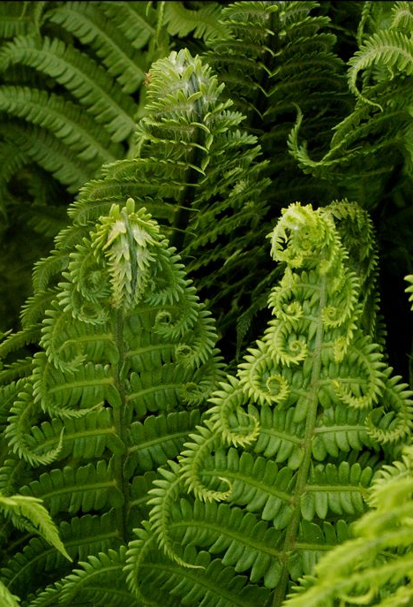
Requirement 1
Name three ways in which plants are important to animals. Name a plant that is protected in your state or region, and explain why it is at risk.

Slide 8
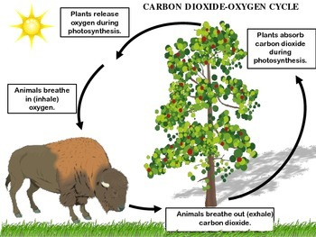
Requirement 1
Plants produce the oxygen that animals breath.

Slide 9
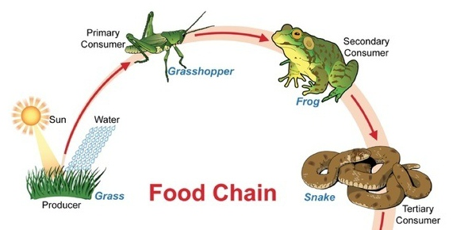
Requirement 1
Plants are the base of the food chain for all animals.

Slide 10
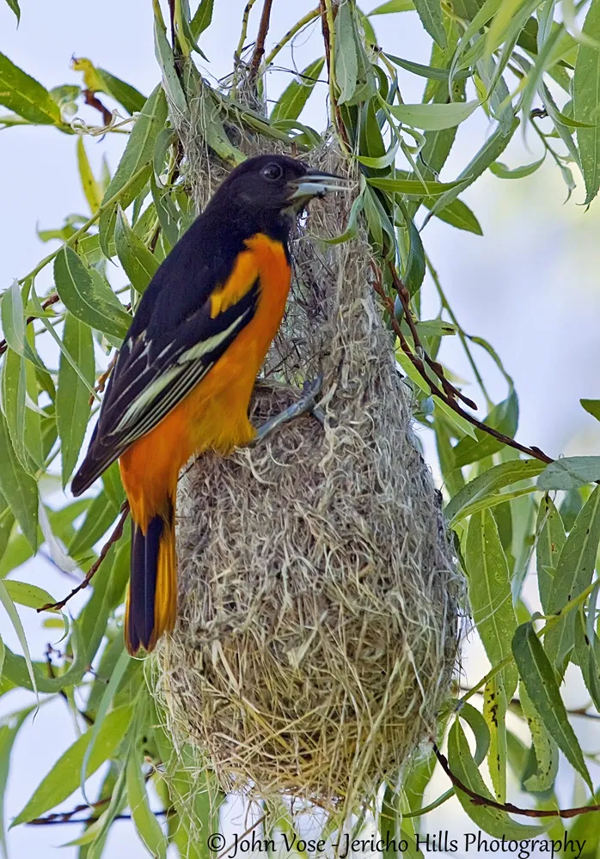
Requirement 1
Plants provide shelter and nesting habitat for many animals.

Slide 11
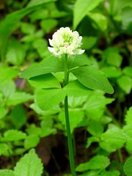
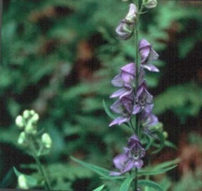
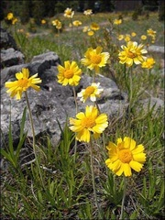
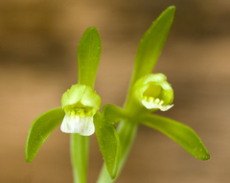
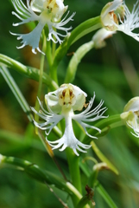
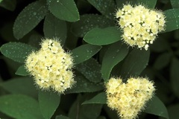
Requirement 1
1.
2.
3.
Endangered Plants in Ohio
There are six plant species classified as endangered in Ohio.
1. Running Buffalo Clover
2. Northern Monkshood
3. Lakeside Daisy
4. Small Whorled Pogonia
5. Eastern Prairie White Fringed Orchid
6. Appalachian Spiraea
These plants are endangered in Ohio from over-collecting, destruction of habitat, and competing invasive plants.
4.
5.
6.

Slide 12
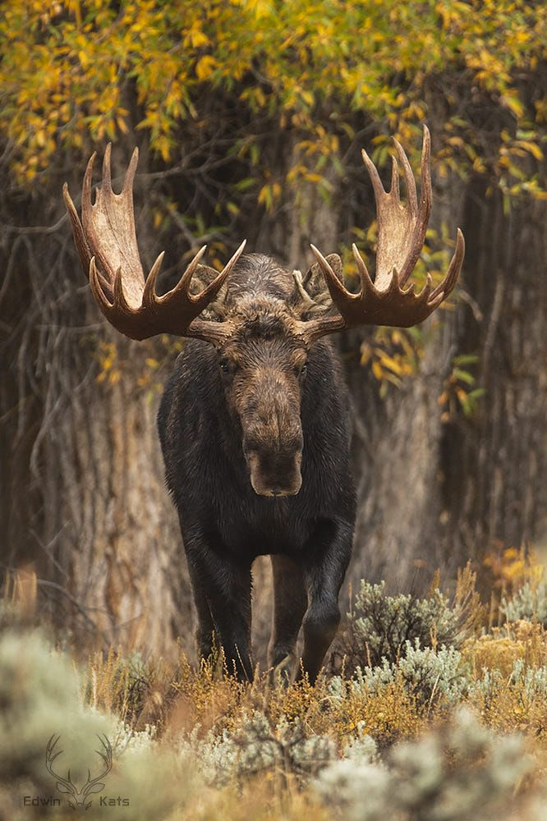
Requirement 2
Name three ways in which animals are important to plants. Name an animal that is protected in your state or region, and explain why it is at risk.

Slide 13
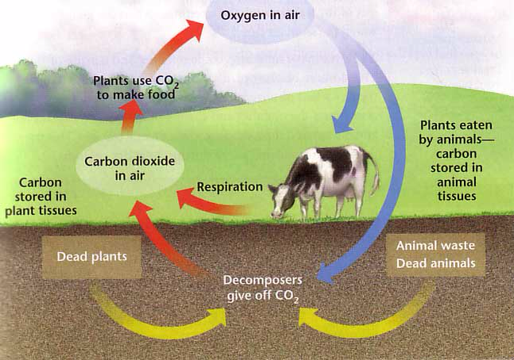
Requirement 2
Animals release carbon dioxide which plants take in during photosynthesis.

Slide 14
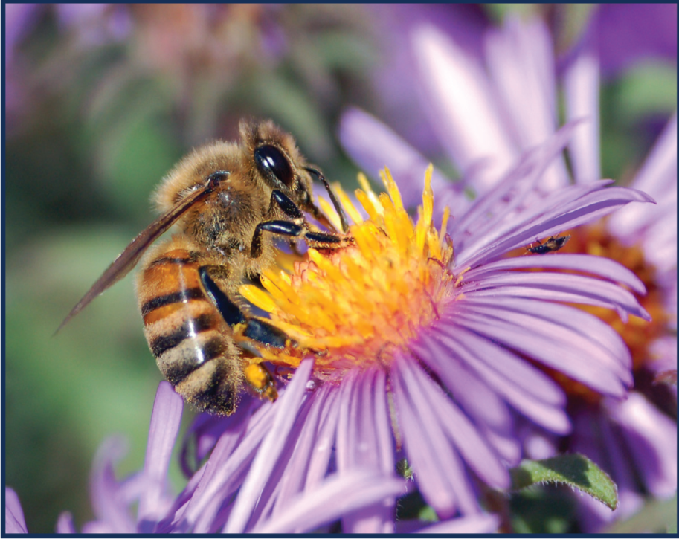
Requirement 2
Animals help pollinate many plants

Slide 15
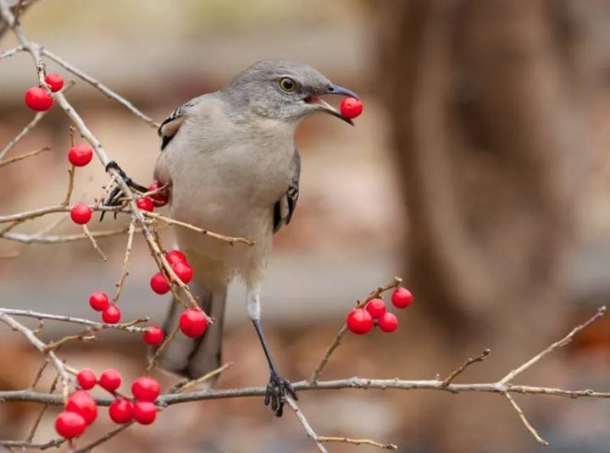
Requirement 2
Animals help disperse the seeds of many plants.

Slide 16
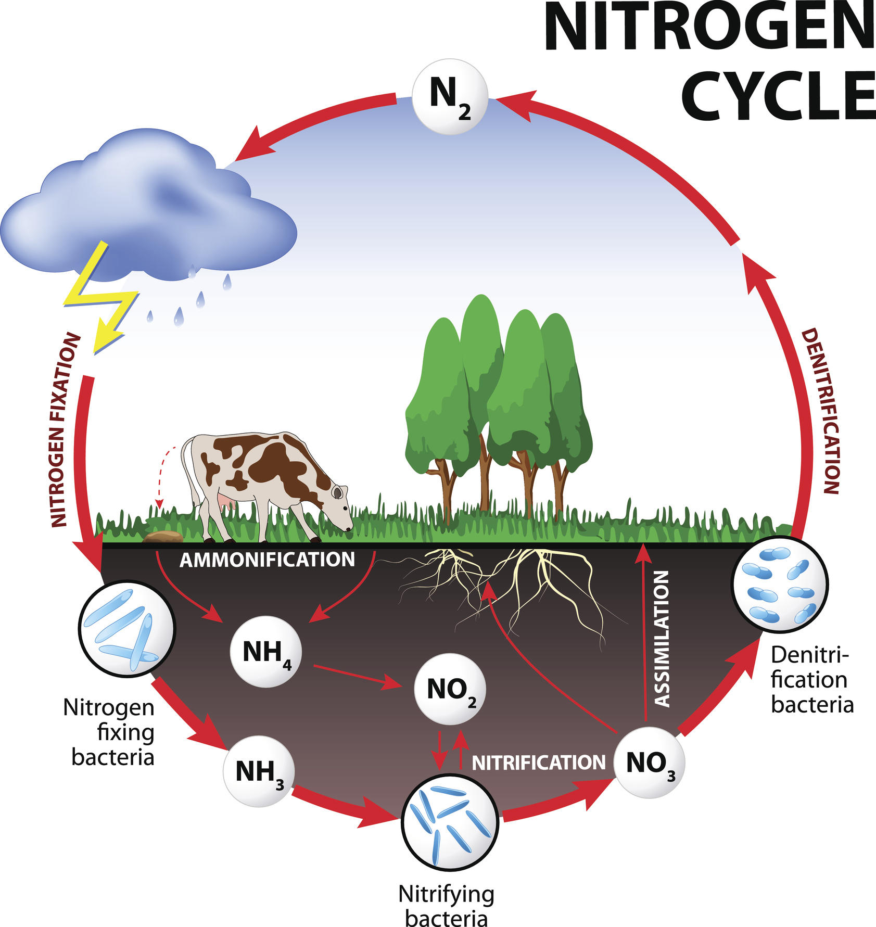
Requirement 2
Animals fertilize the soil for plants during defecation, urination, and decomposition upon death.

Slide 17
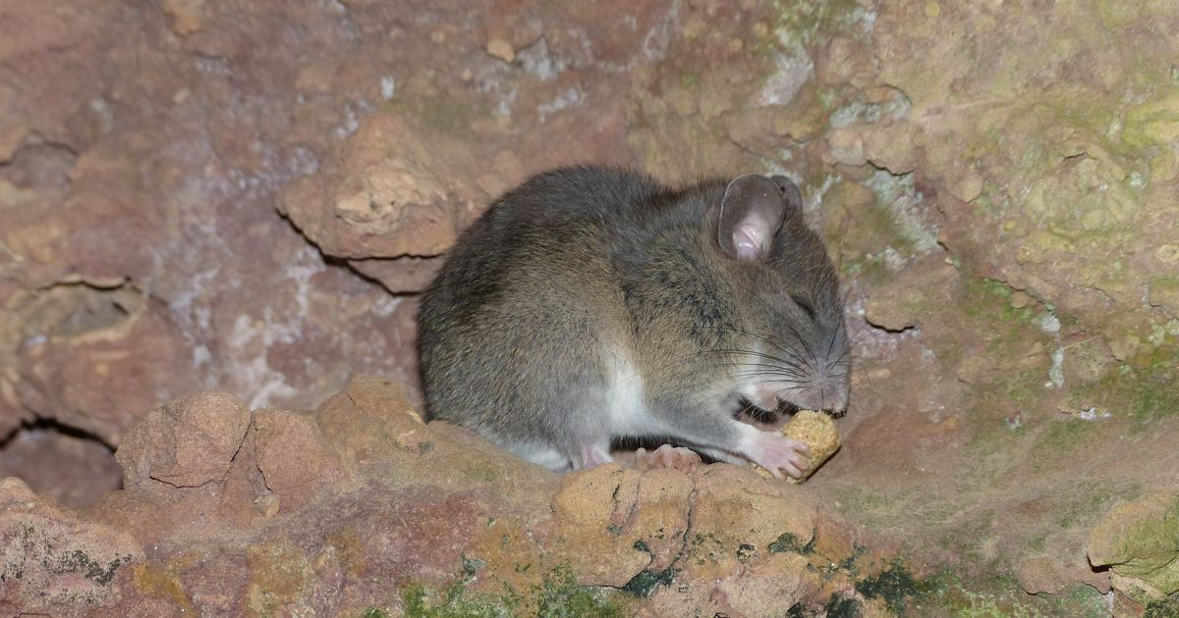
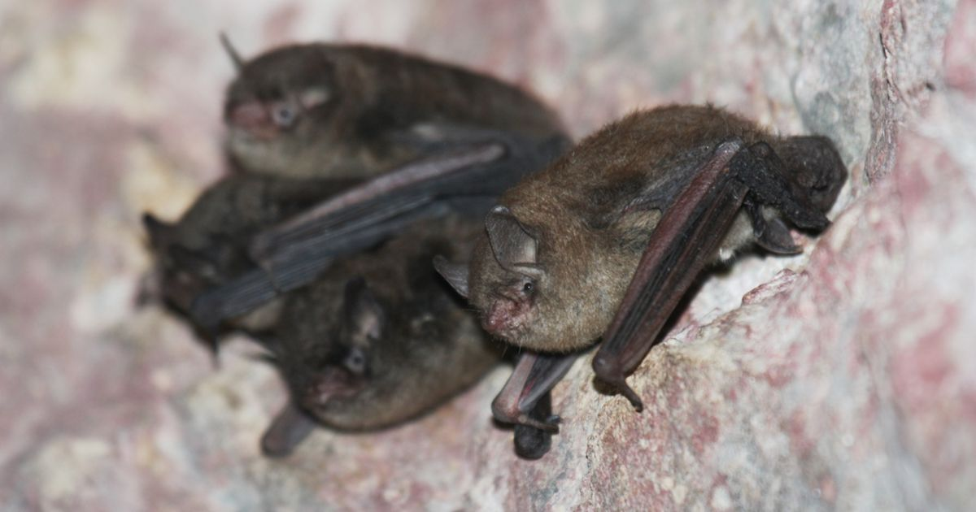
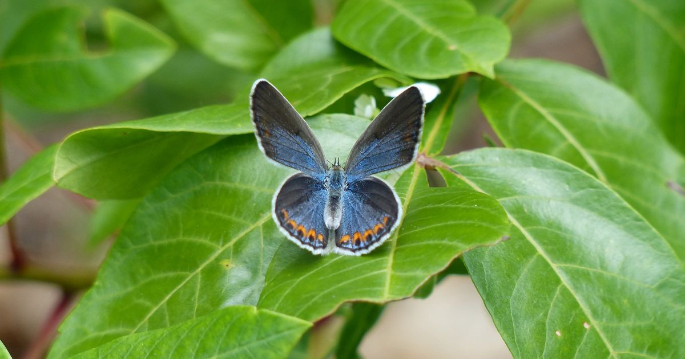
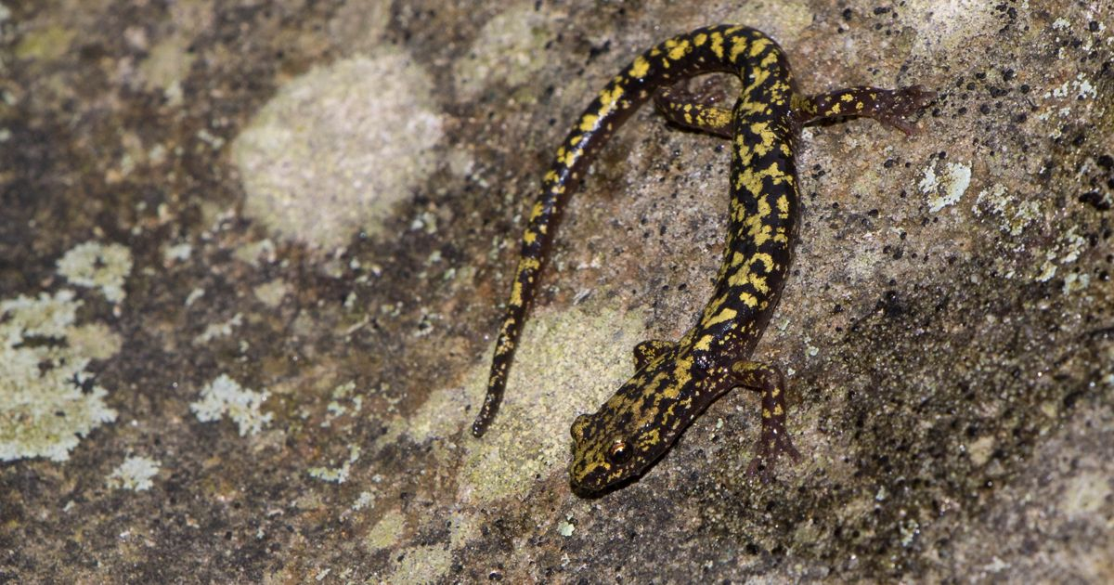
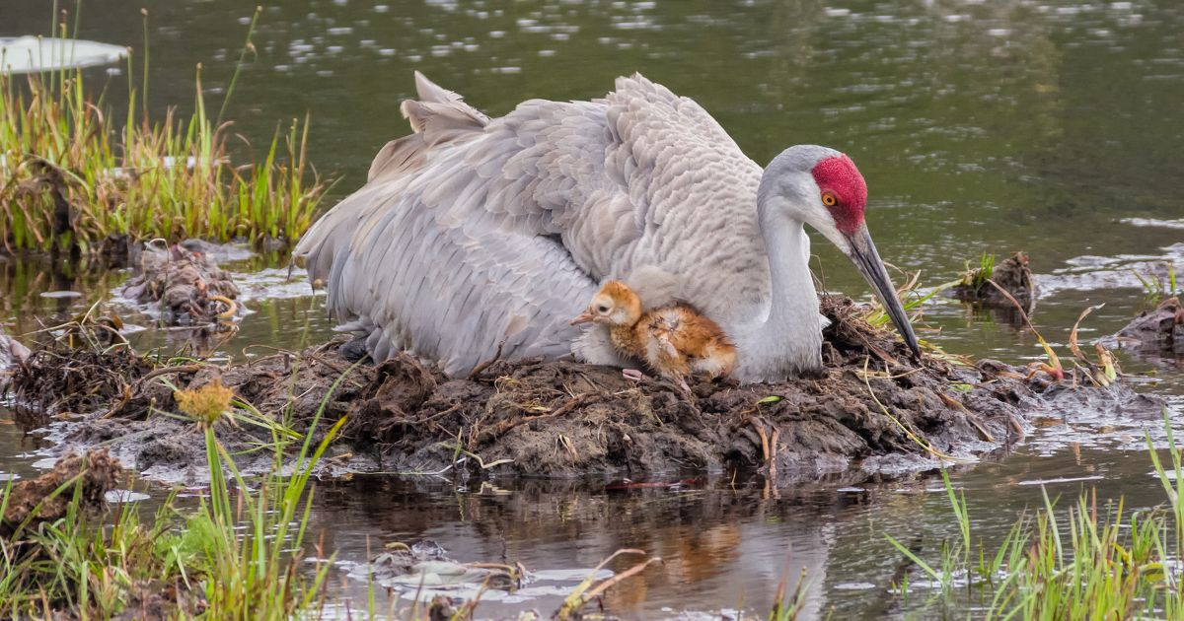
Requirement 2
Click on the following link for the full list of the 19 Endangered Animals in Ohio.
The major reason for the decline of most of these species is the loss of habitat.
Allegheny Woodrat
Indiana Bat
Karner Blue Butterfly
Green Salamander
Sandhill Crane

Slide 18
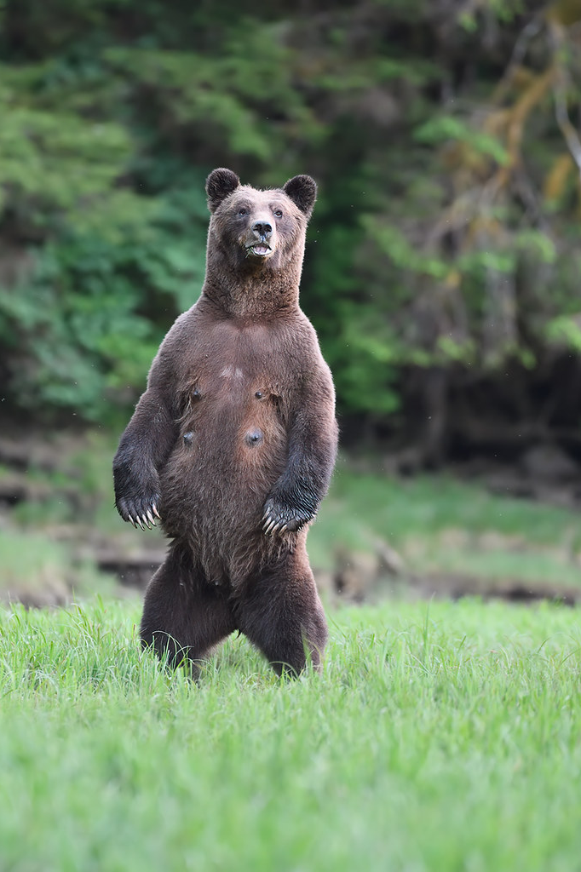
Requirement 3
Explain the term "food chain." Give an example of a four-step land food chain and a four-step water food chain.

Slide 19
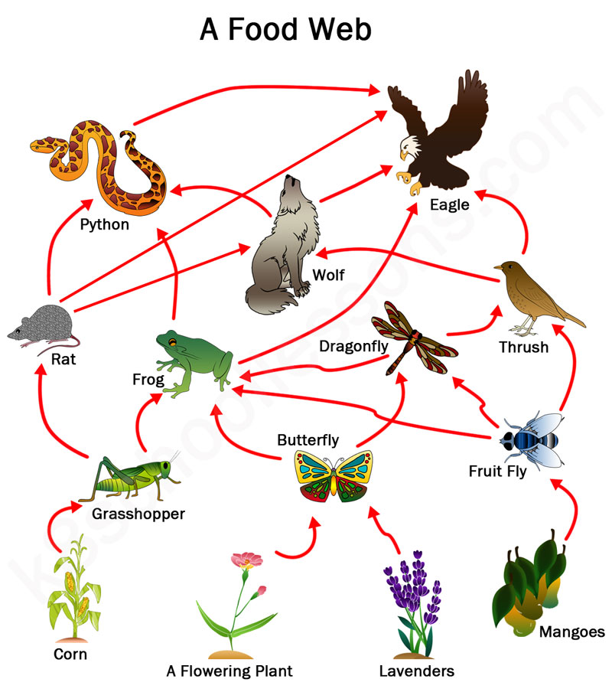
Requirement 3
In ecology, a food chain is a series of organisms that eat one another so that energy and nutrients flow from one to the next. Food chains intertwine locally into a food web because most organisms consume more than one type of animal or plant.

Slide 20
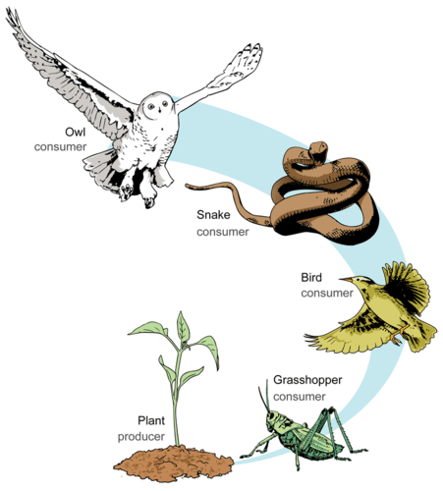
Requirement 3
Terrestrial Food Chain

Slide 21
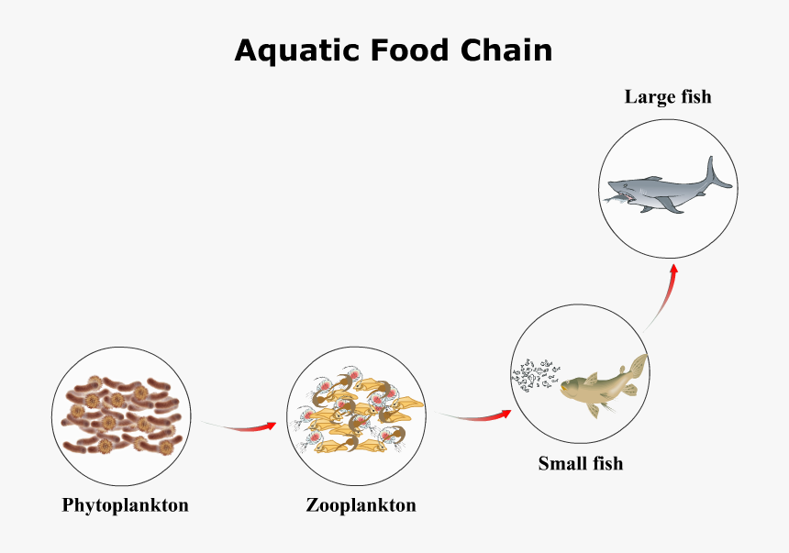
Requirement 3

Slide 22
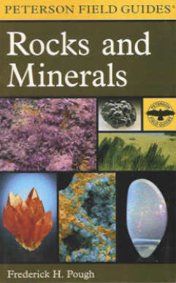
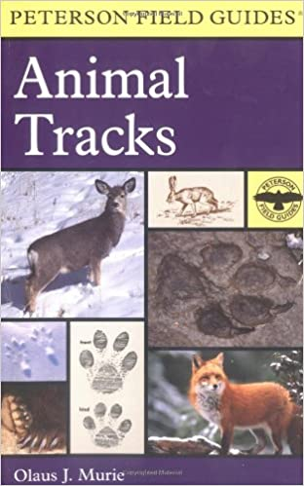

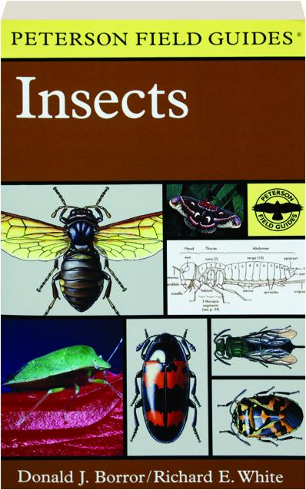
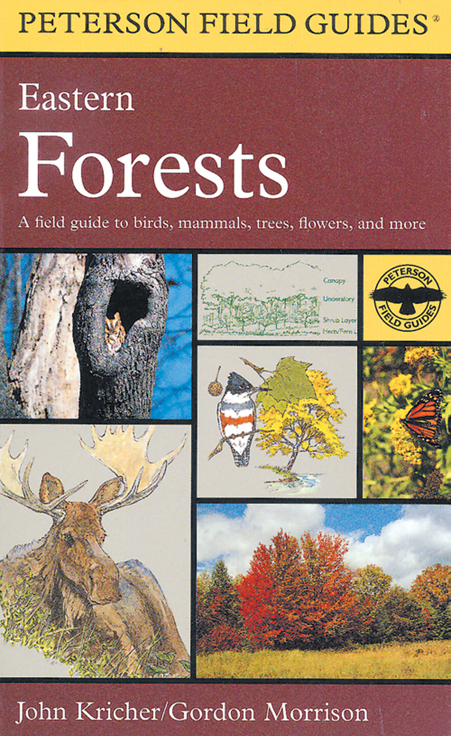
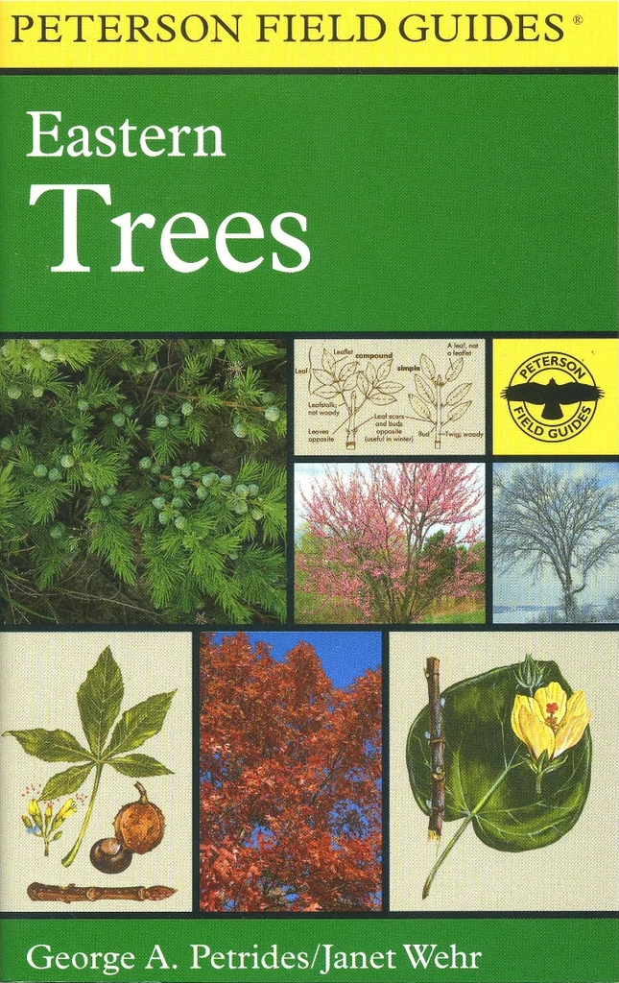
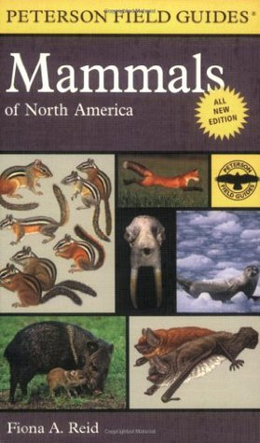
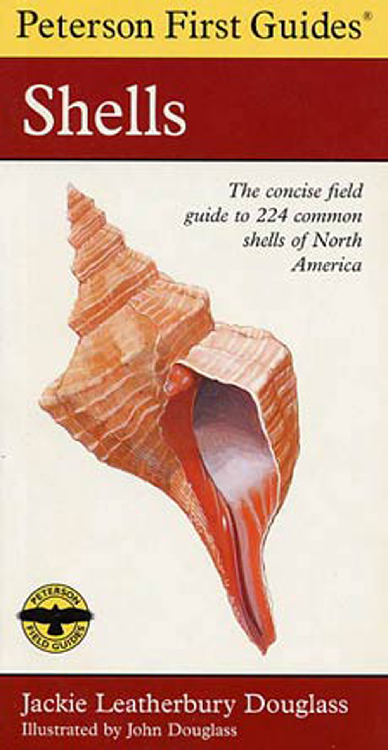
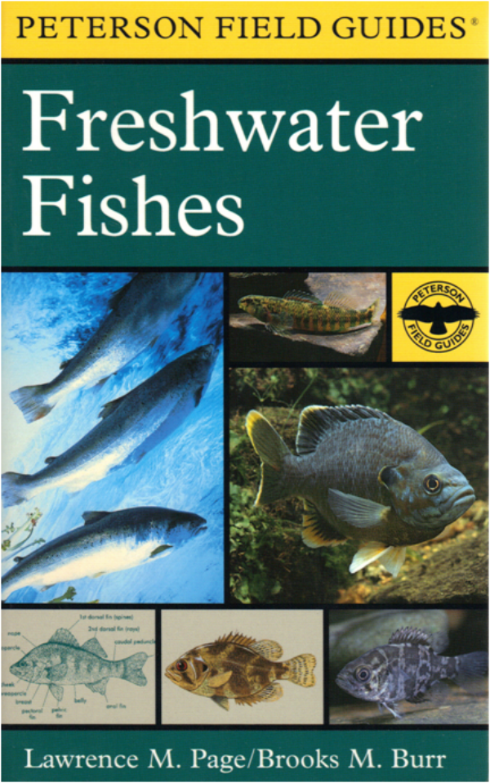
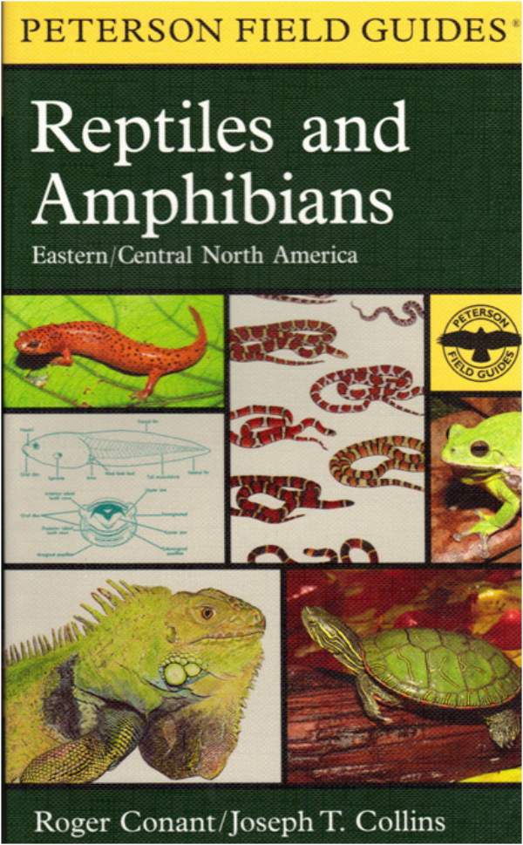

Requirement 4
Field guides to use for meeting the identification requirements of Requirement 4 can typically be found in your local library.

Slide 23
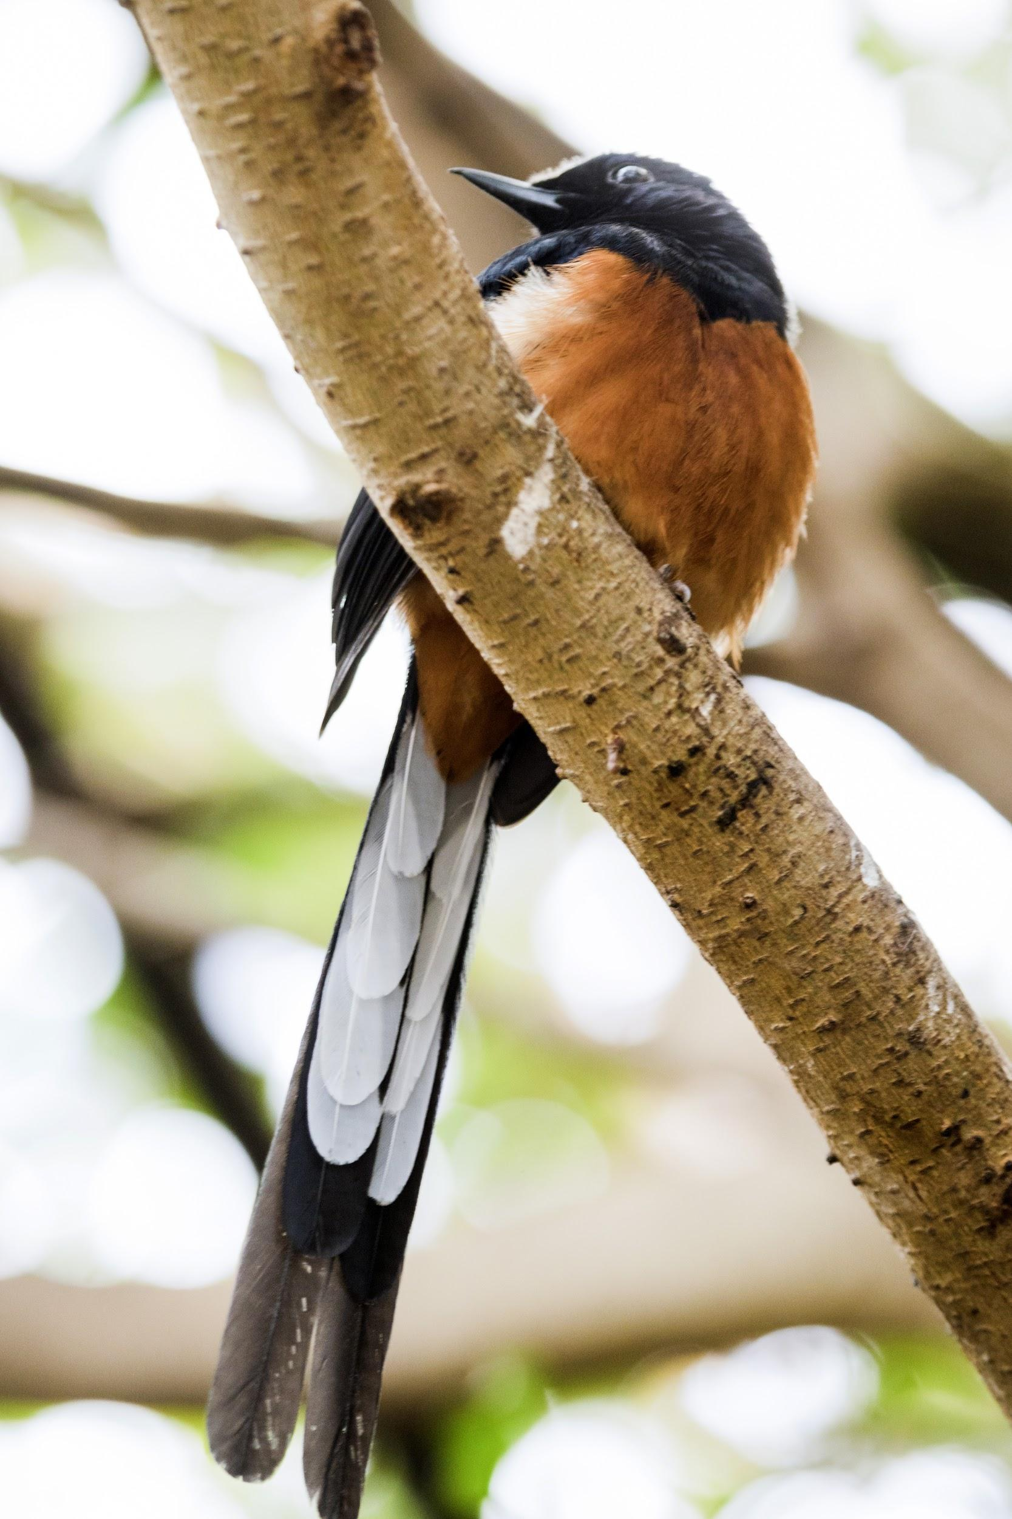
Requirement 4a
Do all the requirements in FIVE of the following fields:
  BIRDS
    In the field, identify eight species of birds.
    Make and set out a birdhouse OR a feeding station OR a birdbath. List what birds used it during a period of one month.

Slide 24
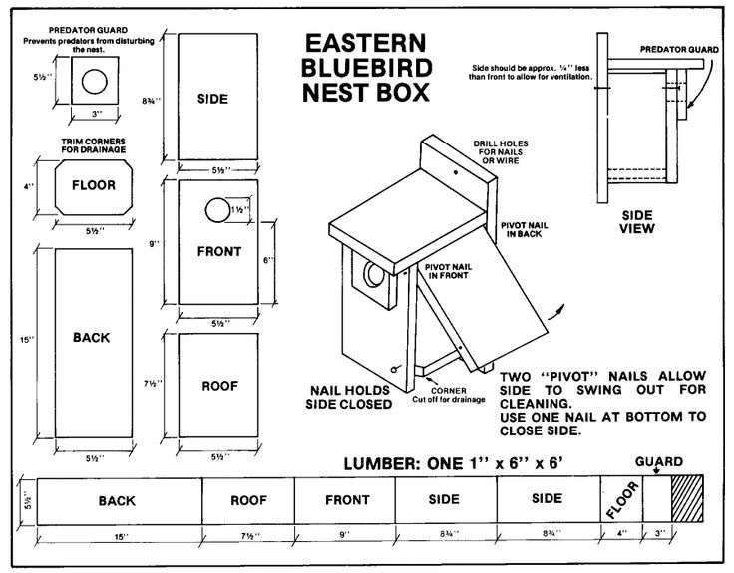

Slide 25
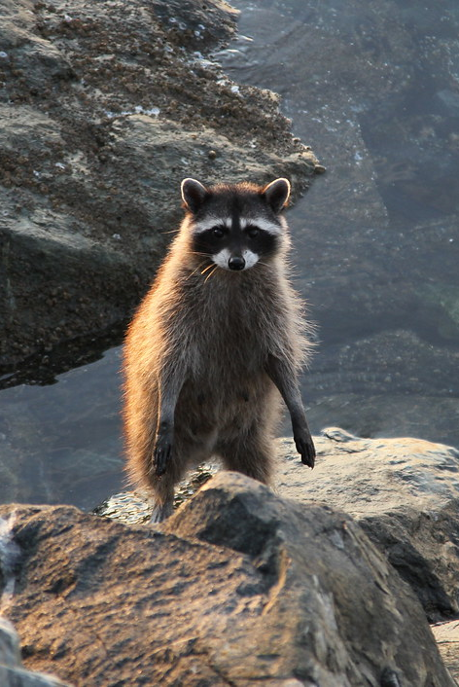
Requirement 4b
Do all the requirements in FIVE of the following fields:
  MAMMALS
    In the field, identify three species of wild mammals.
    Make plaster casts of the tracks of a wild mammal.

Slide 26
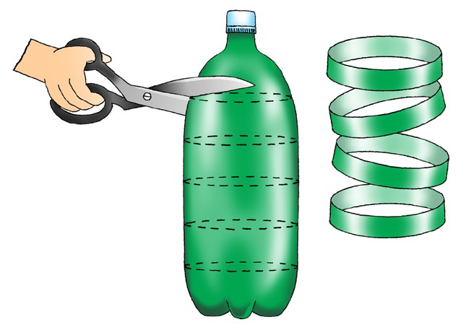
Requirement 4b
    Making plaster casts of the tracks of a wild mammal.
It is easy to make casts of animal tracks. All you need is a 2-liter soda bottle cut into 2 inch sections and some plaster of Paris.
First locate a track with clean features. Look in damp or sandy areas where the soil is soft. Being careful not to alter the track imprint, remove any debris or loose soil from the track. Then place the soda bottle ring over the track and press it lightly into the soil to seal it.
Next, mix 1/4 to 1/2 cup plaster of Paris with water until the consistency is similar to pancake batter. Pour the plaster into the plastic ring, covering the track and filling to a depth of about 1”.
Let the plaster dry at for least 1 hour before moving the ring. After the plaster dries for 24 hours, you can remove it from the ring.

Slide 27
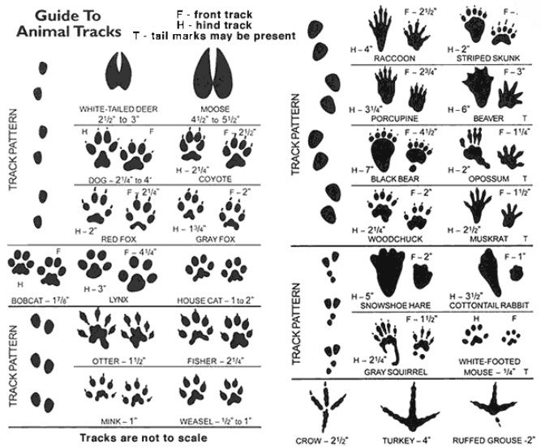

Slide 28
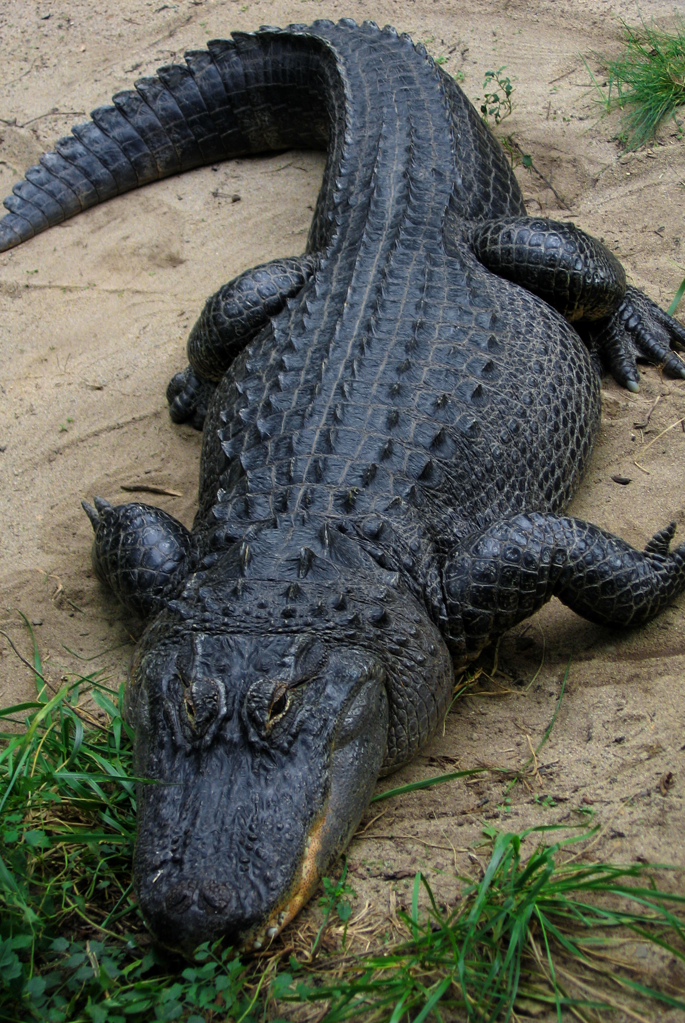
Requirement 4c
Do all the requirements in FIVE of the following fields:
  REPTILES and AMPHIBIANS
    Show that you can recognize the venomous snakes in your area.
    In the field, identify three species of reptiles or amphibians.
    Recognize one species of toad or frog by voice;
    OR identify one reptile or amphibian by eggs, den, burrow or other signs.

Slide 29
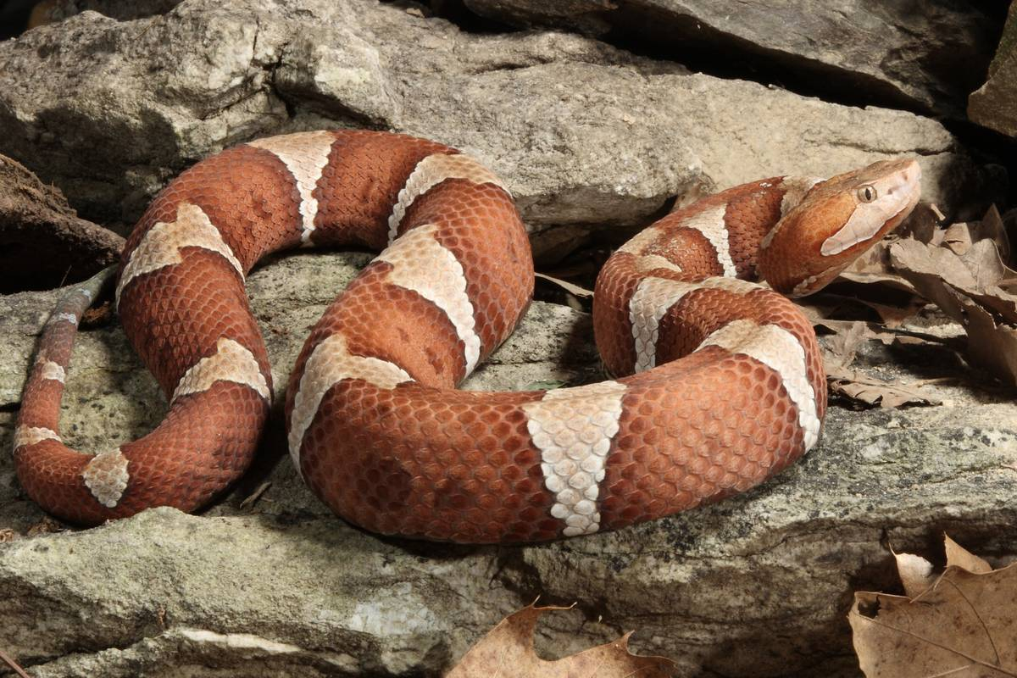
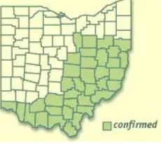
Requirement 4c
Venomous Snakes of Ohio
Northern Copperhead
It loves to eat small rodents (like mice), but it will also go after frogs, small snakes, small birds, and insects.
Female copperheads have a territory of around eight acres while the males may roam up to 24 acres.
Watch for them around old buildings, old logging sawmill slab piles, rock crevices, and areas bordering swamps.
They are year-round residents of Eastern and Southern Ohio.

Slide 30
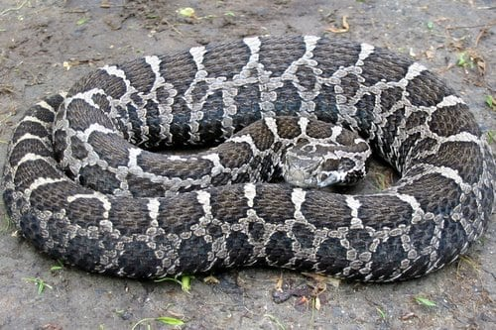
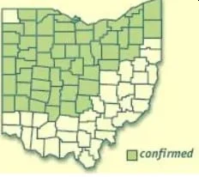
Requirement 4c
Venomous Snakes of Ohio
Massasauga Rattlesnake
The Eastern Massasauga Rattlesnake is named after a combination of two words from the language of the Chippewa tribe of Native Americans.
They prefer to stay hidden and are found in wet prairies, early succession fields, and sedge meadows.
These Ohio year-long residents hibernate in small groups in moist soil.
Young birds, shrews, mice, voles, salamanders, and other small species are regular meals for this recluse.

Slide 31
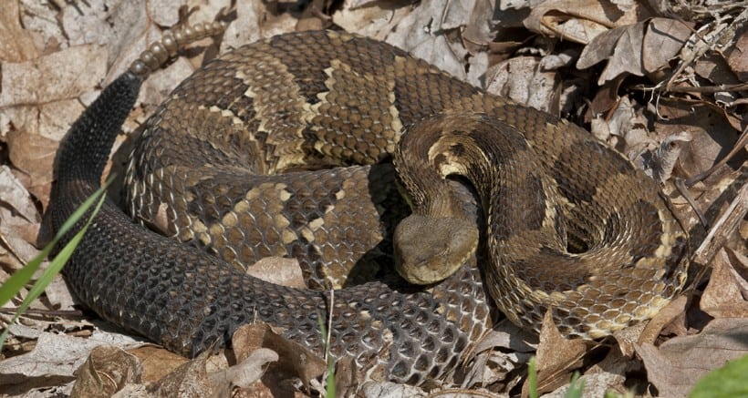
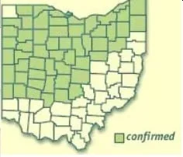
Requirement 4c
Venomous Snakes of Ohio
Timber Rattlesnake
Timber Rattlesnakes are found in wooded areas and will sun themselves where the sunlight penetrates the leaf canopy.
Deep rock crevices are their preferred hibernating areas and den sites.
Squirrels, chipmunks, rats, and mice are often on the menu for the Timber Rattler.
Timber Rattlesnake are found mostly in the northern half of the state.

Slide 32
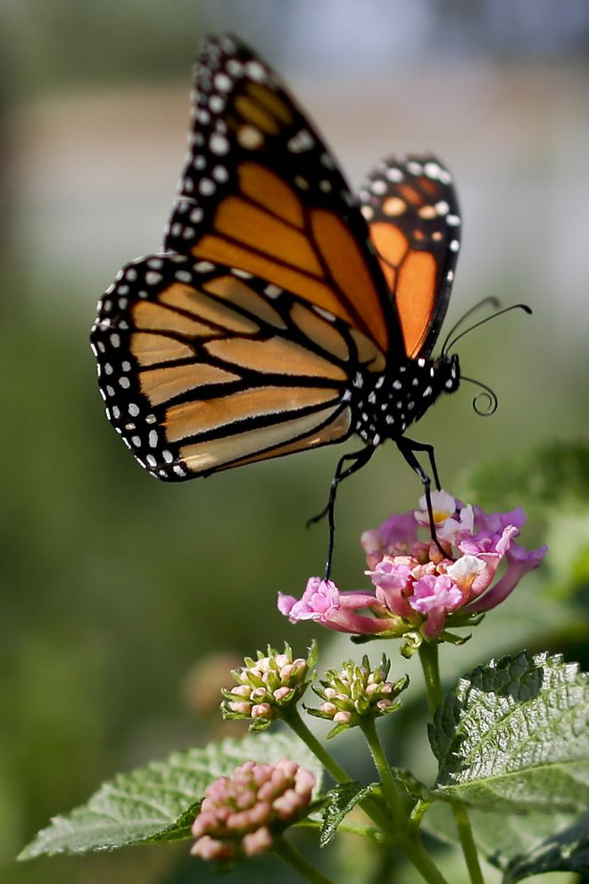
Requirement 4d
Do all the requirements in FIVE of the following fields:
  INSECTS and SPIDERS
    Collect and identify either in the field or through photographs 10 species of insects or spiders. Photos may be taken with your own equipment or gathered from other sources.
    Hatch an insect from the pupa or cocoon;
    OR hatch adults from nymphs;
    OR keep larvae until they form pupae or cocoons;
    OR keep a colony of ants or bees through one season.

Slide 33
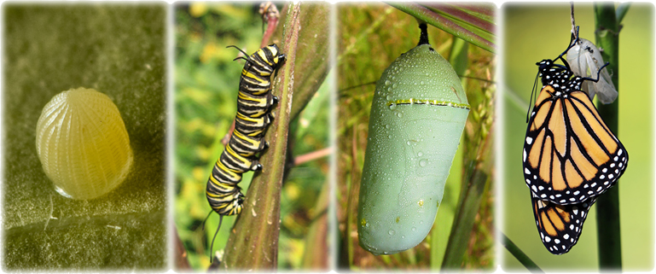
Requirement 4d
Use the following link for practical tips on successfully rearing Monarch Butterflies and releasing them into the wild.

Slide 34
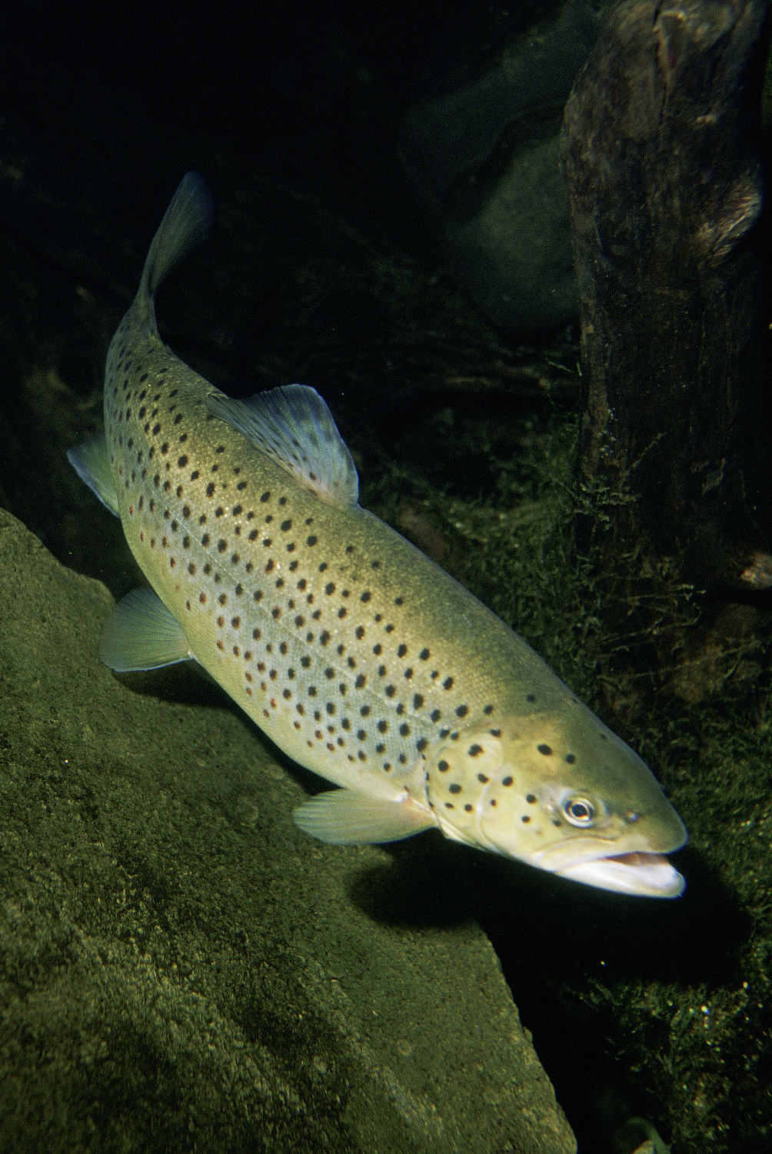
Requirement 4e
Do all the requirements in FIVE of the following fields:
  FISH
    Identify two species of fish native to your area.
    Collect four kinds of animal food eaten by fish in the wild.

Slide 35
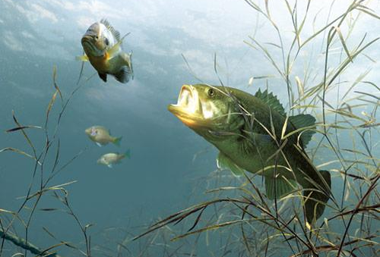




Requirement 4e
Adult fish eat crustaceans, frogs, larval and adult insects, and live fish.
Mayfly Larva and Adult

Slide 36

Requirement 4f
Do all the requirements in FIVE of the following fields:
  MOLLUSKS AND CRUSTACEANS
    Identify five species of mollusks and crustaceans.
    Collect, mount, and label six shells.

Slide 37

Requirement 4g
Do all the requirements in FIVE of the following fields:
  PLANTS
    In the field, identify 15 species of wild plants.
    Collect and label seeds of six plants;
    OR the leaves of 12 plants.

Slide 38

Requirement 4h
Do all the requirements in FIVE of the following fields:
  SOILS AND ROCKS
    Collect and identify soils found in different layers of a soil profile.
    Collect and identify five different types of rocks from your area.

Slide 39

Requirement 4h
Soil Profile

Slide 40

Requirement 5
Discuss the importance of the Leave No Trace Seven Principles and the Outdoor Code and how they relate to nature. Explain how you have followed the Leave No Trace Seven Principles and the Outdoor Code while in natural areas during field observation, specimen collection, and identification.

Slide 41

Principles of Leave No Trace
Do your part to keep nature natural by following these principles.
Plan ahead and prepare. Proper planning and preparation increases safety, reduces the impact of your visit on the environment, and helps make your outdoor experience more enjoyable.
Travel and camp on durable surfaces. Natural environments are easily damaged by foot traffic. Use existing trails or travel on durable surfaces such as rock, gravel, sand, compacted soil, dry grasses, or snow. Large groups should spread out to avoid creating new trails. Keep campsites small.
Dispose of waste properly (pack it in, pack it out). Any material people leave behind pollutes the environment and might create a health hazard for wildlife or other visitors. Pack out any trash and leftover food. Dispose of human waste by digging catholes 6 to 8 inches deep and 200 feet away from water, trails, and campsites.

Slide 42
Principles of Leave No Trace
Do your part to keep nature natural by following these principles.
Leave what you find. Observe the interesting things you find, but do not disturb them. Use established campsites and do not alter them in any way. Restore campsites to pristine condition before you leave.
Minimize campfire impacts. Use a lightweight stove when cooking in the backcountry. If you need to build a fire, keep it small and use only dead or downed wood. Never cut down limbs or trees for firewood.
Respect wildlife. Stay far enough away from animals that your presence does not disturb their natural activity. Store food, food scraps, and trash securely to prevent animals from eating food that is not part of their natural diet. Never feed wild animals.
Be considerate of other visitors. Let everyone enjoy nature. Travel and camp quietly and away from other people. Blend in by wearing subdued colors. Leave pets and portable audio devices at home.

Slide 43

Requirement 6
Do the following:
  Explain what succession is to your counselor.
  Visit a natural area (forest, grassland, meadow, water feature) and explain what stage of succession (both plant and animal) the area is in. Talk about what community/succession stages may have been there before and what community/succession stages may replace what you see now. Discuss what disturbances or changes have taken place in the past to create this landscape and what changes may occur in the future to change the landscape further.

Slide 44

Succession
Ecological succession is the process by which the mix of species and habitat in an area changes over time.
Gradually, these communities replace one another until a “climax community”—like a mature forest—is reached, or until a disturbance, like a fire, occurs.

Slide 45
How does succession occur?
The sequential progression of species during succession is not random.
At every stage certain species have evolved traits to exploit the particular conditions of the community.
Initially only a small number of pioneer species from surrounding habitats are capable of thriving in a disturbed habitat.
As new plant species take hold, they modify the habitat by altering such things as the amount of shade on the ground or the mineral composition of the soil.
These changes allow other species that are better suited to this modified habitat to succeed (replace) the old species.

Slide 46
How does succession occur?
These newer species are superseded, in turn, by still newer species.
A similar succession of animal species occurs, and interactions between plants, animals, and environment influence the pattern and rate of successional change.
If left undisturbed, succession may reach a climax, which produces a stable community dominated by a small number of prominent species.
This state of equilibrium, called the climax community, is thought to result when the web of biotic interactions becomes so intricate that no other species can be admitted.

Slide 47

Forest Succession

Slide 48

Pond or Lake Succession
1
2
3
1
5
6

Slide 49
Requirement 7
Do ONE of the following:
  Identify three career opportunities that would use skills and knowledge in Nature. Pick one and research the training, education, certification requirements, experience, and expenses associated with entering the field. Research the prospects for employment, starting salary, advancement opportunities and career goals associated with this career. Discuss what you learned with your counselor and whether you might be interested in this career.
  Identify how you might use the skills and knowledge in Nature to pursue a personal hobby. Research the additional training required, expenses, and affiliation with organizations that would help you maximize the enjoyment and benefit you might gain from it. Discuss what you learned with your counselor and share what short-term and long-term goals you might have if you pursued this.

Slide 50

Wildlife Biologist
Description:
  Wildlife biologists study animals and their ecosystems, conducting research to protect endangered species, manage wildlife populations, and improve conservation efforts. They work for government agencies, conservation groups, and research institutions.
Education & Training:
  Bachelor’s degree in wildlife biology, ecology, or environmental science (required).
  Master’s degree for advanced research or specialized roles.
  Coursework in zoology, botany, statistics, and conservation is essential.
Certification & Licensing:
  Optional certifications, such as the Certified Wildlife Biologist (CWB) from The Wildlife Society, can improve job prospects.
  Some positions may require a state-issued permit for handling wildlife.

Slide 51

Wildlife Biologist
Experience & Expenses:
  Internships and volunteer work with national parks, zoos, or conservation organizations provide experience.
  College tuition: $20,000–$50,000 per year.
  Fieldwork may require travel, hiking, and working in remote locations.
Job Prospects & Salary:
  Median salary: ~$67,000 per year (U.S. Bureau of Labor Statistics).
  Job growth: ~5% from 2022 to 2032.
  Advancement: Can lead to senior research positions, project management, or policy advisory roles.
Career Goals:
  Protect endangered species.
  Improve wildlife conservation and management.
  Conduct scientific research to inform environmental policies.

Slide 52

Park Ranger (Conservation Officer)
Description:
  Park rangers manage and protect state and national parks, enforcing regulations, assisting visitors, and preserving natural landscapes. Some specialize in law enforcement, education, or search and rescue.
Education & Training:
  Bachelor’s degree in environmental science, forestry, or park management (preferred but not always required).
  Some positions require law enforcement training.
Certification & Licensing:
  Some states require a state park ranger exam or federal training through the National Park Service (NPS).
  First aid, CPR, and wilderness survival certifications are often required.

Slide 53

Park Ranger (Conservation Officer)
Experience & Expenses:
  Seasonal or volunteer work with the National Park Service or state parks helps gain experience.
  College tuition: $15,000–$40,000 per year.
  Federal jobs may require additional law enforcement training.
Job Prospects & Salary:
  Median salary: ~$40,000–$70,000 per year.
  Job growth: Stable, but dependent on government funding.
  Advancement: Senior ranger, park manager, or director of park services.
Career Goals:
  Preserve and protect natural landscapes.
  Educate visitors about nature and conservation.
  Enforce environmental and park laws.

Slide 54

Environmental Scientist
Description:
  Environmental scientists study pollution, climate change, and natural resource conservation. They work in government agencies, consulting firms, and research organizations to solve environmental problems and develop policies.
Education & Training:
  Bachelor’s degree in environmental science, biology, or chemistry.
  Master’s degree for leadership or specialized research roles.
  Coursework includes ecology, soil science, and environmental law.
Certification & Licensing:
  Certifications such as Certified Environmental Scientist (CES) improve job prospects.
  Some states require licensing for environmental consultants.

Slide 55

Environmental Scientist
Experience & Expenses:
  Internships with environmental agencies or research labs provide experience.
  College tuition: $20,000–$50,000 per year.
  Fieldwork may involve outdoor research and laboratory analysis.
Job Prospects & Salary:
  Median salary: ~$76,000 per year (BLS).
  Job growth: ~6% from 2022 to 2032.
  Advancement: Senior scientist, project manager, or policy advisor.
Career Goals:
  Solve environmental issues related to pollution and sustainability.
  Develop policies for cleaner air, water, and land.
  Conduct research on climate change and conservation.

Slide 56

Marine Biologist
Description:
  Marine biologists study ocean ecosystems, marine life, and the effects of human activity on aquatic environments. They work in research institutions, conservation organizations, aquariums, and government agencies.
Education & Training:
  Bachelor’s degree in marine biology, oceanography, or environmental science (required).
  Master’s degree or Ph.D. for advanced research positions.
  Courses include marine ecology, chemistry, and aquatic conservation.
Certification & Licensing:
  Scuba certification (e.g., PADI Open Water Diver) may be required for field research.
  Certifications in scientific diving or boat operation may be necessary.

Slide 57

Marine Biologist
Experience & Expenses:
  Internships with marine research centers or aquariums provide experience.
  College tuition: $20,000–$60,000 per year.
  Fieldwork may require travel, diving, and working in remote locations.
Job Prospects & Salary:
  Median salary: ~$66,000 per year (BLS).
  Job growth: 5% from 2022 to 2032.
  Advancement: Senior researcher, conservation director, or university professor.
Career Goals:
  Study and protect marine species.
  Research the effects of climate change on oceans.
  Work in marine conservation or policy advocacy.

Slide 58

Forester
Description:
  Foresters manage forests and natural resources for conservation, recreation, and sustainable logging. They work for government agencies, private companies, and conservation organizations.
Education & Training:
  Bachelor’s degree in forestry, environmental science, or natural resource management.
  Some positions require a Master’s degree in forest ecology or conservation.
  Coursework includes tree biology, fire management, and soil science.
Certification & Licensing:
  Some states require a forestry license to work on public lands.
  Certification from the Society of American Foresters (SAF) can improve job prospects.

Slide 59

Forester
Experience & Expenses:
  Internships or summer jobs with the U.S. Forest Service or state agencies provide experience.
  College tuition: ~$20,000–$50,000 per year.
  May require fieldwork in remote areas.
Job Prospects & Salary:
  Median salary: ~$64,000 per year (BLS).
  Job growth: 4% from 2022 to 2032.
  Advancement: Forest manager, environmental consultant, or conservation director.
Career Goals:
  Manage forests for conservation and sustainability.
  Prevent and fight wildfires.
  Improve forest ecosystems and protect wildlife habitats.

